Slide 1

The right to work and access to the labor market
Prof. Liat Ayalon
Bar Ilan University, Israel
Presented as part of the GA Open-ended Working Group on Ageing for the purpose of strengthening the protection of the human rights of older persons
March 31, 2021
United Nations, New York

Slide 2
The right to work!
The right to work is a human right- in every age
Right to stay in the workforce
Right to reenter the workforce
Right for training and learning
Some people must work (ILO, 2017-2019)
  Low-middle income countries
  Women
  Low-paid workers

Slide 3
Benefits to the individual
Maintaining daily routines (Sewdas et al., 2017)
Mental wellbeing (Segel-Karpas, Ayalon, & Lachman, 2018)
Cognitive wellbeing (Meng et al., 2017)
Social network (Segel-Karpas, Ayalon, & Lachman, 2016)
A sense of meaning and generativity
(Mor-Barak, 1995)
Mortality (Noelke & Beckfield, 2014)

Slide 4
Benefits to the organization and to society at large
Prevents group-think
(Kunze & Boehm, 2013)
Complementary knowledge and skills (Kunze & Boehm, 2013)
Improved productivity on creative tasks (Backes-Gellner et al., 2013)
Intergenerational contact reduces ageist stereotypes (Burnes et al., 2019)

Slide 5
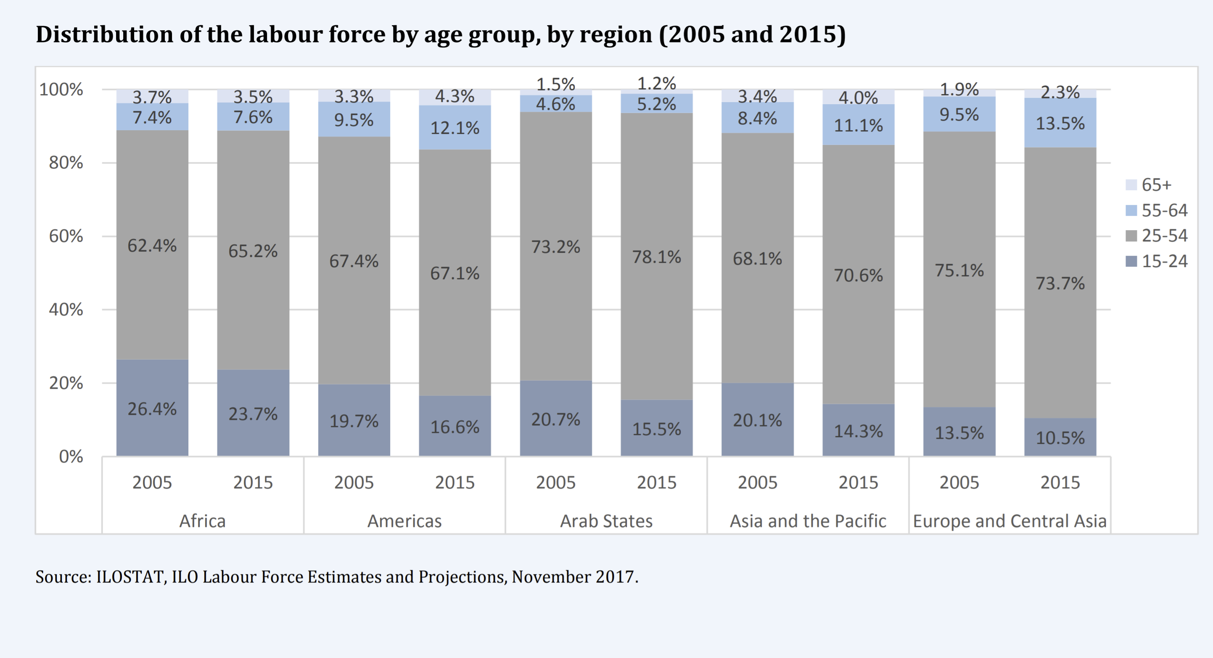

Slide 6
Informal work (care)
Unrewarded
No pension or career advancement
Not acknowledged
“There are only four kinds of people in the world: Those who have been caregivers. Those who are currently caregivers. Those who will be caregivers, and those who will need a caregiver.”
Rosalyn Carter

Slide 7
What prevents older adults from working?
Stereotypes (Ng & Feldman, 2012):
  Less motivated
  Less willing to participate in training and career development
  Less willing to change
  Less trusting
  Less healthy
  More vulnerable to work-family imbalance
  Older people should give the right of the way to younger people (North & Fiske, 2017)
Self-stereotypes (Gaillard & Desmette, 2010)

Slide 8
What prevents older adults from working?
Implicit/explicit discrimination at the organizational level (Naegele et al., 2018):
  In advertising for a job (young and dynamic firm)
  In hiring
  In promoting and sending for training
  In layoffs
  In interpersonal relations

Slide 9
What prevents older adults from working?
Discrimination:
No UN convention for the human rights of older people
The court of justice of the EU allows differential treatment based on age in the field of employment if reasonably justified (Age-Platform Europe, 2021)
Mandatory retirement age-at the country level
During the pandemic - differential lockdown, exit and return to work strategies based on chronological age (Ayalon et al., 2020)

Slide 10
What can we do better?
At the organizational level
(Wang & Fang, 2020):
  Age-inclusive management
  Peer mentoring
  Participative decision-making
  Training to counter age-related stereotypes
  The importance of life-long learning (Ates & Alsal, 2012)

Slide 11
What can we do better?
At the policy level (Sig & De-Luigi, 2007):
  Target the general public, workers and employers
  A comprehensive approach
    Anti-discrimination legislation
    Age-sensitive human resources management
    Restrictive- move away from collective insurance rights
    Incentive - encourage to remain longer
    Educational-positive image of older people
    Promoting part-time employment

Slide 12
What can we do better?
A convention for the rights of older people!
  A normative framework
  A global standard
  An explicit framework which points to human rights violations and discrimination of older people
    The right to work should not be based on age
    Mandatory retirement age should be abolished (Age-Platform Europe, 2021)

Slide 13
X
Chronological age
Retirement
Education
Work and family
(Riley & Riley, 1994)

Slide 14
The right to work and access to the labor market
Thank you!
Liat.Ayalon@biu.ac.il

